Slide 1
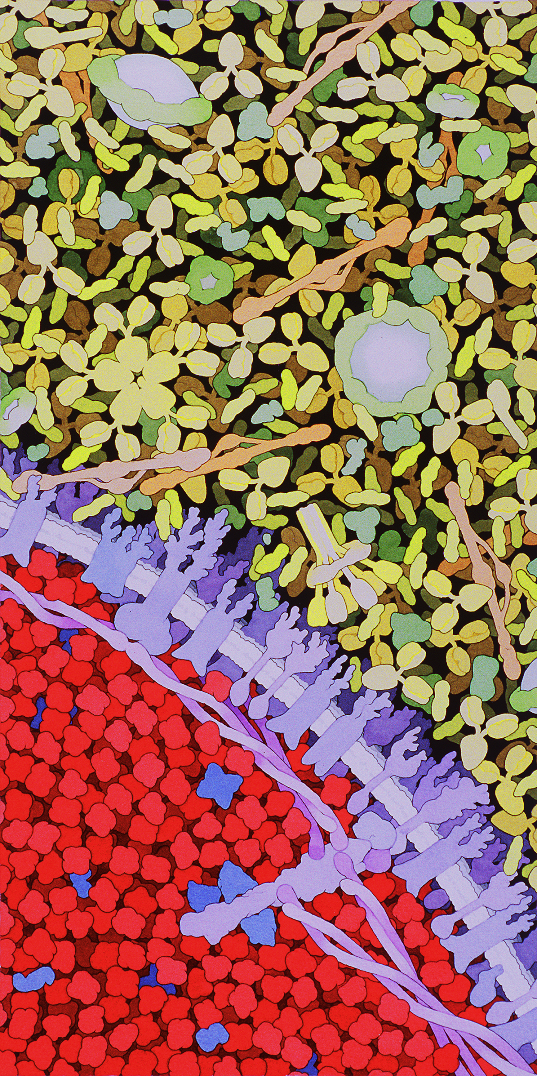
Single Cell,
Big Data
Tom White
Bristech, 7 November 2019
Illustration by David S. Goodsell, the Scripps Research Institute.

Slide 2
Laserson Lab, Mount Sinai
Uri Laserson
Ryan Williams

Slide 3
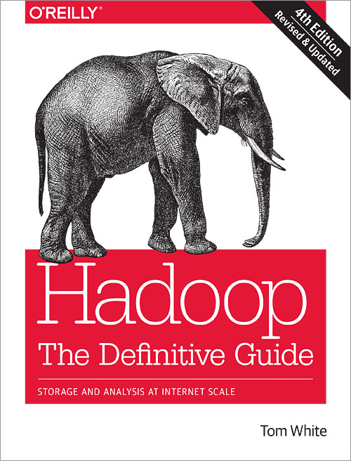
About me
Freelance software engineer
Contributor to bioinformatics projects (GATK, Scanpy)
Software engineer and data scientist at Cloudera (2008-2018)
Committer and PMC member on multiple Apache Hadoop projects
Author of “Hadoop: The Definitive Guide”

Slide 4
Cells
Data
Algorithms
Compute
Notes:
This talk could have been called “Cells, Data, Algorithms, and Compute” since that is what I’m going to talk about. In that order.
First, I will talk about cells, then about the data we capture about cells. Then I’ll look at some of the core algorithms for analysing cell data. Then finally about the compute technology - CPUs and GPUs and the compute frameworks being used.

Slide 5
Cells

Slide 6
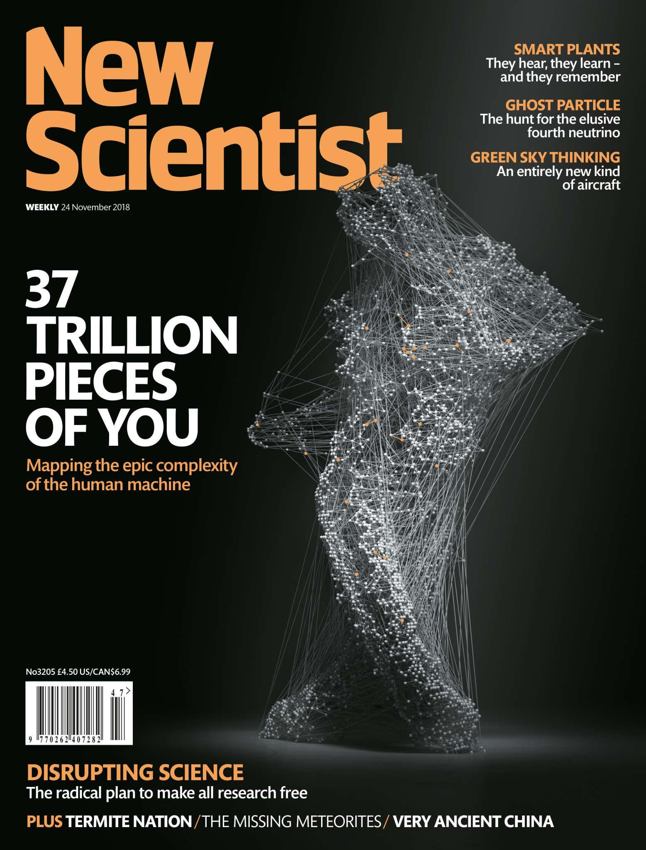
Notes:
There are 37 trillion cells in your body.
And each cell has an astonishing amount of internal complexity.
Indeed the last century or so has been a story of ever increasing knowledge about the workings of the cell.

Slide 7
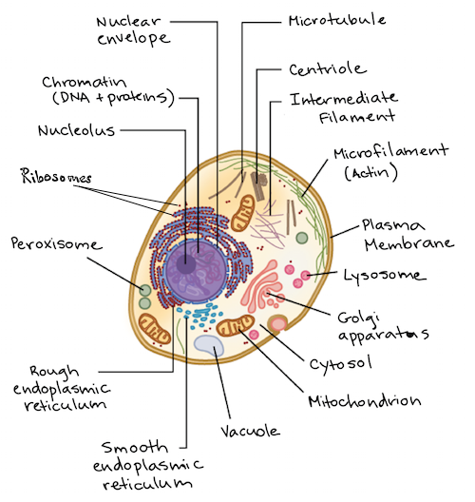
CC BY-NC-SA https://www.khanacademy.org/science/high-school-biology/hs-cells/hs-prokaryotes-and-eukaryotes/a/intro-to-eukaryotic-cells
Notes:
Here’s a diagram of an animal cell.

Slide 8
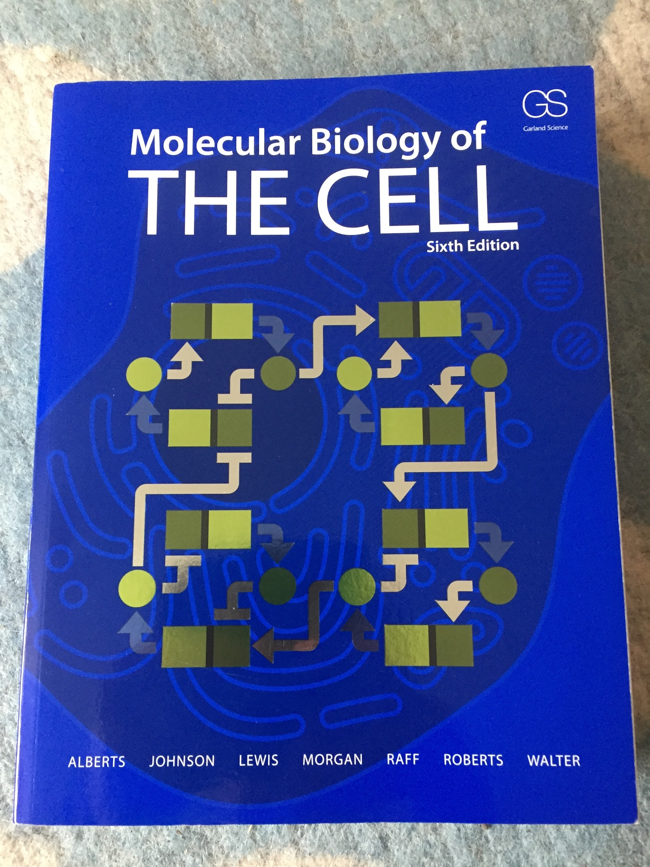
Notes:
The standard textbook on the cell has over 1300 pages.
But - and there’s always a “but” in these things - our understanding has until recently been based on looking at cells in aggregate. We have this intricate knowledge of how cells work, but basically we’ve learnt this by averaging across a bunch of cells in a tissue sample.

Slide 9
Drop-seq
http://mccarrolllab.org/dropseq/
Notes:
Over the last decade a new technique has taken off. Under the name “single cell sequencing” it has become possible to isolate and capture one cell at a time, allowing us to measure things about an individual cell. So we are no longer averaging.
The video here shows a barcode being introduced into individual cells. The barcode adds a unique ID to the cell’s RNA so it can be identified later during processing.

Slide 10
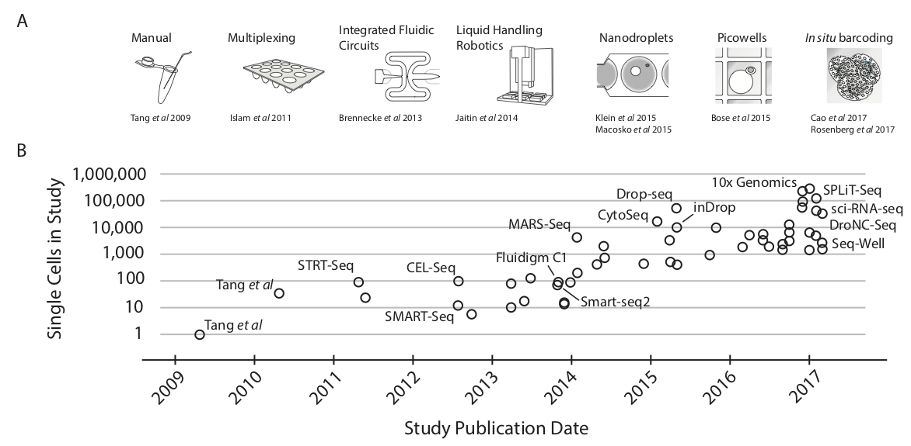
“Exponential scaling of single-cell RNA-seq in the last decade”, Svensson et al, 2017, https://arxiv.org/pdf/1704.01379.pdf
Notes:
As the technology has progressed, it has become possible to look at batches of single cells. That is, we can sequence ever larger collections of single cells in one go. Today we have studies of 1 million cells or more.

Slide 11
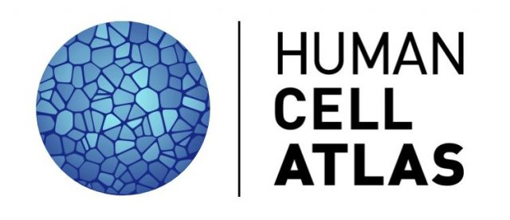
Notes:
The technological advances behind SC sequencing led to the launch of an ambitious project in 2016.
The Human Cell Atlas is a bold international collaboration to map all of the cells in the human body.

Slide 12
Human Genome Project
To sequence and map the human genome
Human Cell Atlas
To create comprehensive reference maps of all human cells
Notes:
At the beginning of the century the first draft of the Human Genome Project was completed. Like the HCA it was a large international collaboration with a grand vision - to sequence and map the human genome.
The goal of the HCA is to create comprehensive reference maps of all human cells
It’s interesting to look at the wording here. There is a strong mapping metaphor, which is a continuation from the HGP from the beginning of the century. Why the term “map”?
Maps are very intuitive. Make it easy to explain to people. However, to make a map is to take a stand, to have an opinion, since maps can only cover a tiny fraction of reality. They miss a lot out. For example, the HGP mapped base pairs (A, G, C, T) - 3 billion - but not methelation which has implications for how genes are expressed (in an individual).

Slide 13
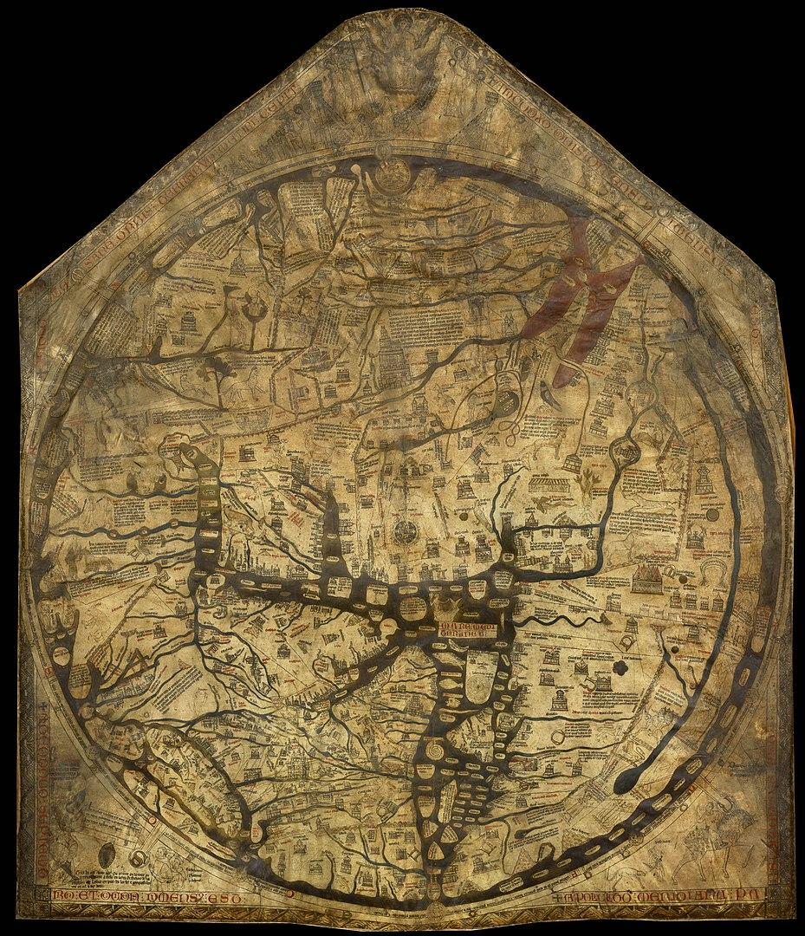
Hereford Mappa Mundi
By Unknown - unesco.org.uk, Public Domain, https://commons.wikimedia.org/w/index.php?curid=41201813
Notes:
If you look at geographical maps, the same selection is taking place.
This is a map of the world - the Mappa Mundi from 1300. You can go and see it in Hereford Cathedral to this day.

Slide 14
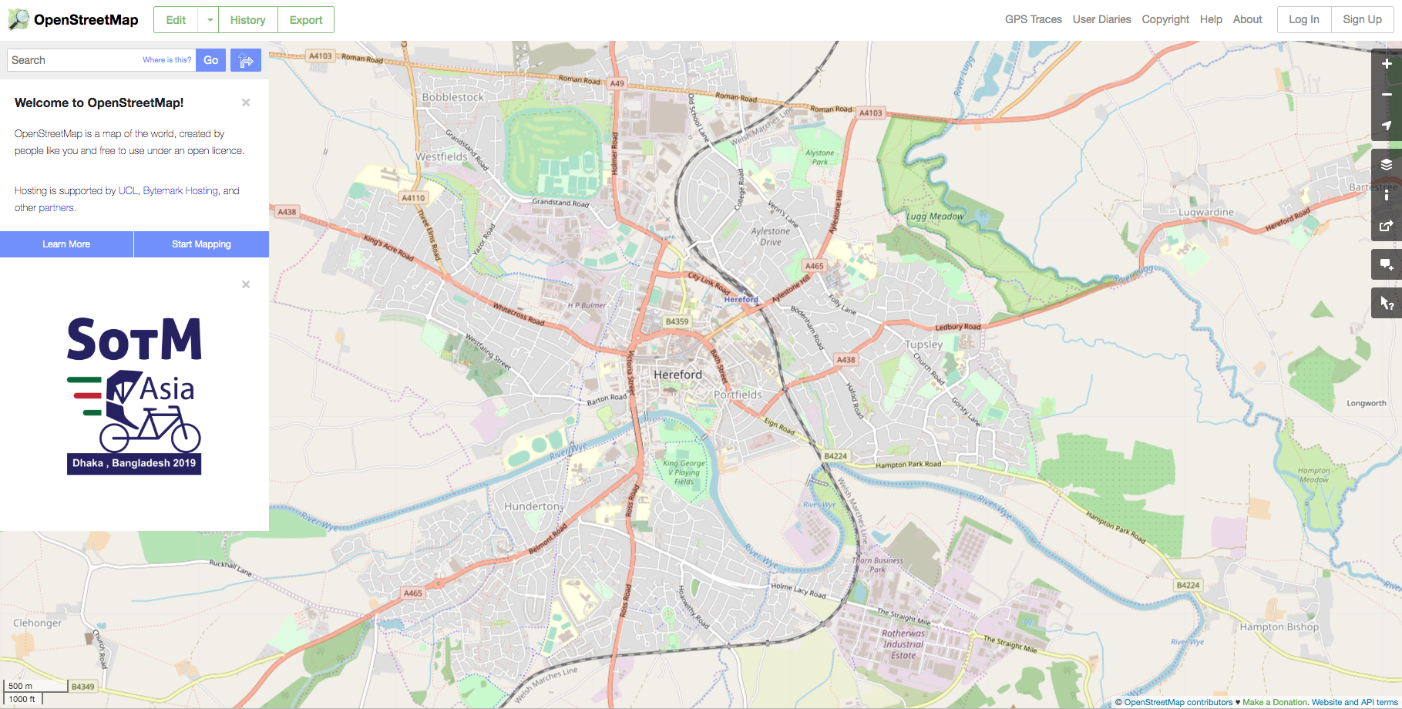
Notes:
This is a modern OSM of Hereford. It has details that would have been almost unimaginable to the makers of the Mappa Mundi.
Similarly, the HCA is about increasing the resolution of the map of cells. It should also help us see things we haven’t seen before. New maps allow us to make new connections and do new things.

Slide 15
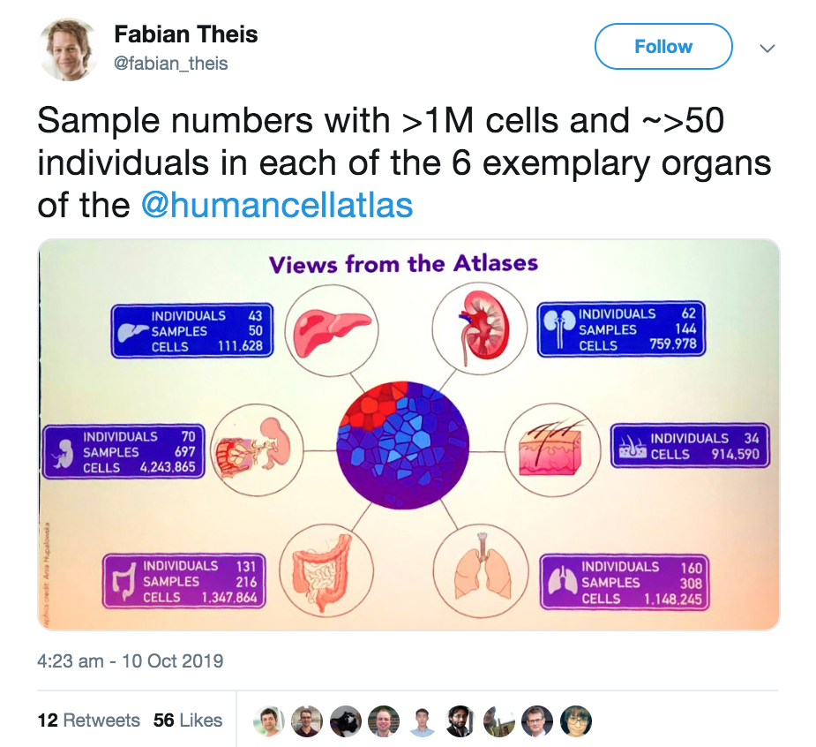
Notes:
This is a recent status report for the HCA.
So - for example - there are over a million cells for lung data - from 160 individuals.
The data is accumulating, and is openly available.

Slide 16
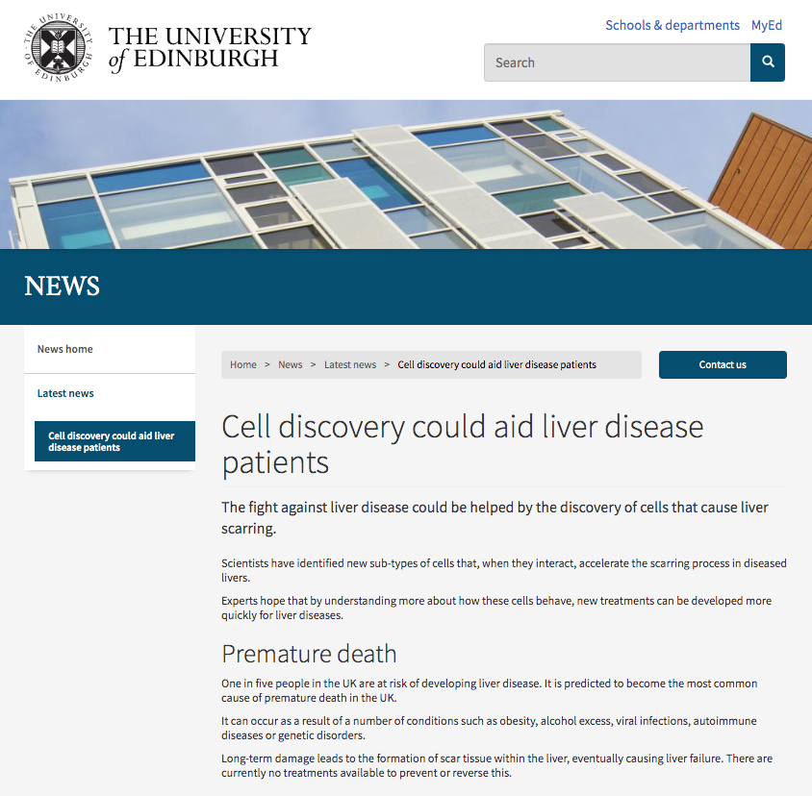
Notes:
One of the goals of the HCA is to give us insights that will help treat disease. To take just one example. This paper from last month from scientists in Edinburgh University identifies a new sub-type of liver cell. Using SC allowed them to find a new cell type. “Experts hope that by understanding more about how these cells behave, new treatments can be developed more quickly for liver diseases.”
So I hope that quick intro gives you an idea of what the technology does, and why people are working on it.

Slide 17
Data
Notes:
To understand the data we are collecting and analysing, we need a tiny bit of basic biology.

Slide 18
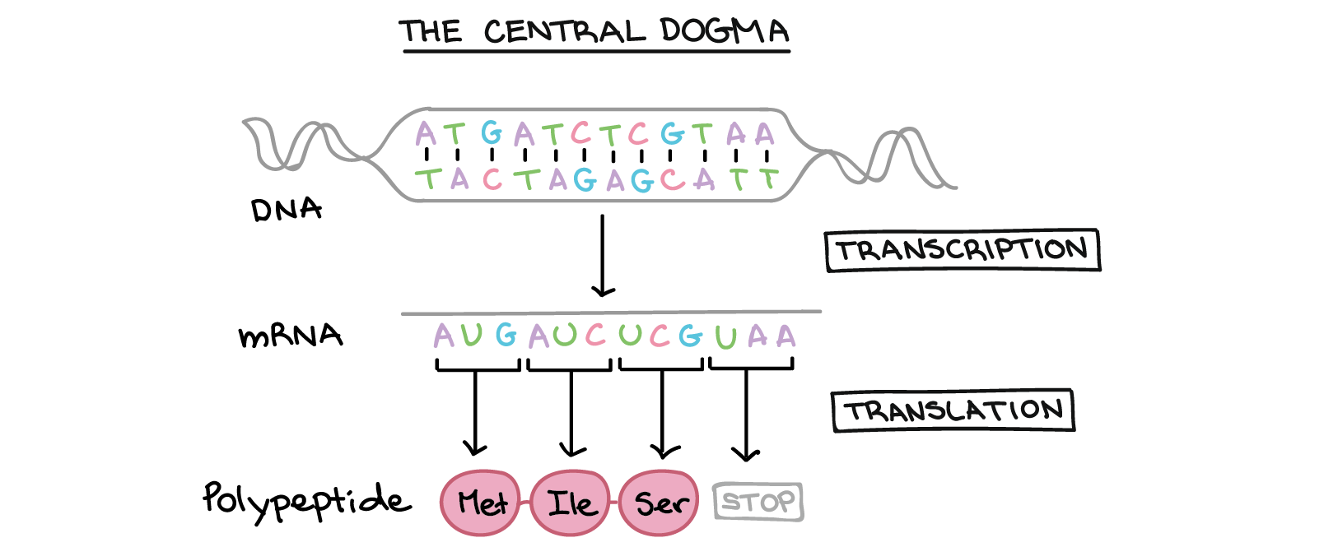
CC BY-NC-SA https://www.khanacademy.org/science/high-school-biology/hs-cells/hs-prokaryotes-and-eukaryotes/a/intro-to-eukaryotic-cells
Notes:
Francis Crick called this the central dogma, which says “DNA makes RNA makes protein”.
In a given cell at a given time, some genes are active and are being transcribed into RNA and translated into proteins.
The idea is that we can see what proteins are being produced by measuring the RNA levels in a cell.

Slide 19
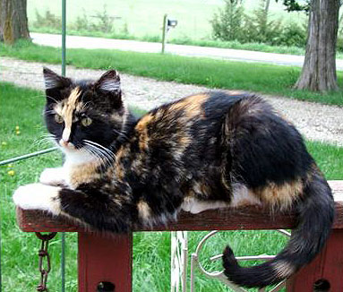
Gene expression
CC BY-SA 2.5, https://commons.wikimedia.org/w/index.php?curid=1036771
Notes:
This is called gene expression.
Which genes are expressed changes over time, by cell, and by cell type.
You can see this in this tortioseshell cat. The different colours are the result of different levels of expression in pigmentation genes.

Slide 20
Gene expression matrix
 | Gene 0 | Gene 1 | Gene 2 | ...
Cell 0 | 0 | 25 | 175 | ...
Cell 1 | 0 | 0 | 354 | ...
Cell 2 | 4 | 13 | 312 | ...
Cell 3 | 11 | 0 | 292 | ...
Cell 4 | 0 | 41 | 164 | ...
... | ... | ... | ... | ...
Notes:
The data structure we get from doing SC sequencing is called a Gene Expression Matrix.
Each row is a cell. Each column is a gene.
There are ~1M cells, and ~30K genes.
The entries are numbers that measure how strongly expressed the gene is (e.g. number of RNA transcripts).
We’ve reduced the complex biology into a simple mathematical object.

Slide 21
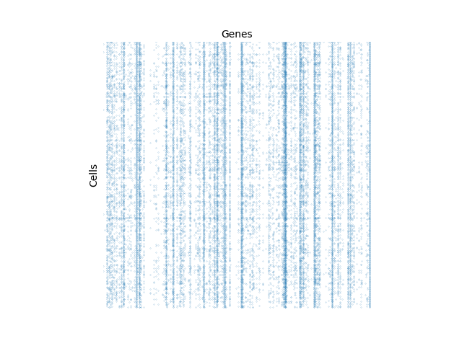
Gene expression matrices are sparse
Notes:
GEMs are sparse. Only around 10% of entries are non-zero.
Some genes are never expressed in this batch - e.g. where the vertical line is always white.
Some are always expressed (blue lines). Some vary from cell to cell.

Slide 22
Representation using scipy.sparse
Notes:
To jump into coding quickly - we can represent a GEM in Python using a sparse matrix.
The 1 million cell dataset takes around ~10GB of memory.

Slide 23
Persistent storage: Zarr
Multi-dimensional chunked storage
Each chunk is a separate file on a filesystem
Typically a cloud store like S3 or GCS
Allows parallel writing, unlike HDF5
Adopted by HCA after benchmarking
Example 2D array
Filesystem footprint:
Metadata (.zarray):
├── .zarray
├── 0.0
├── 0.1
├── 1.0
├── 1.1
{ "shape": [ 20, 20 ], "chunks": [ 10, 10 ], "compressor": { "id": "zlib", "level": 1 }, "dtype": "<i4", "fill_value": 42, "filters": null, "order": "C", "zarr_format": 2 }

Slide 24
Algorithms
Notes:
Next I want to look at some of the algorithms we use to process this data.
The raw input is a big matrix that we can’t really understand.
We want to extract some deeper meaning from it, and see if it offers biological insights.

Slide 25
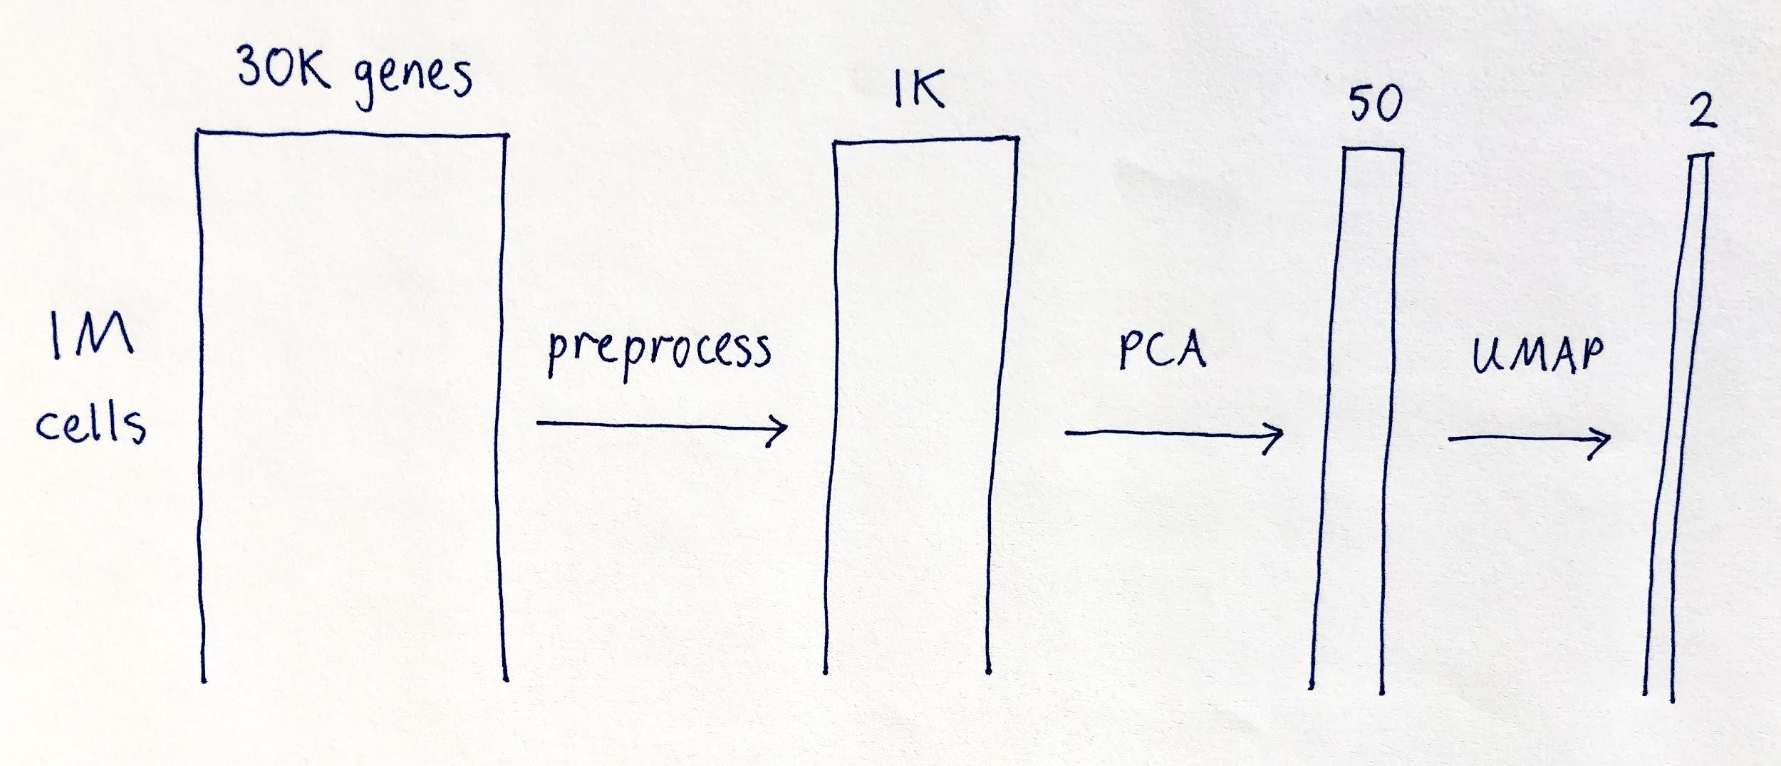
High-level pipeline
Notes:
Like in most data processing we have a pipeline of steps that the data goes through.
We go from a high dimensional representation on the left, to a low dimensional representation on the right.
(There are still a million rows though)
The first step is a preprocessing step. Here we do things like normalization (to correct imbalances between cells and genes that are an artifact of the SC sequencing). We also filter to the top 1000 genes, since they
are likely to be the ones of interest.
The second step is PCA - principle component analysis. This is a standard technique to reduce dimensions. Here we go to 50 dimensions.
Next we go to 2 dimensions for visualization. PCA could go all the way to 2D, but UMAP has some properties that make it attractive. Let’s look at it next.
UMAP = Uniform Manifold Approximation and Projection

Slide 26
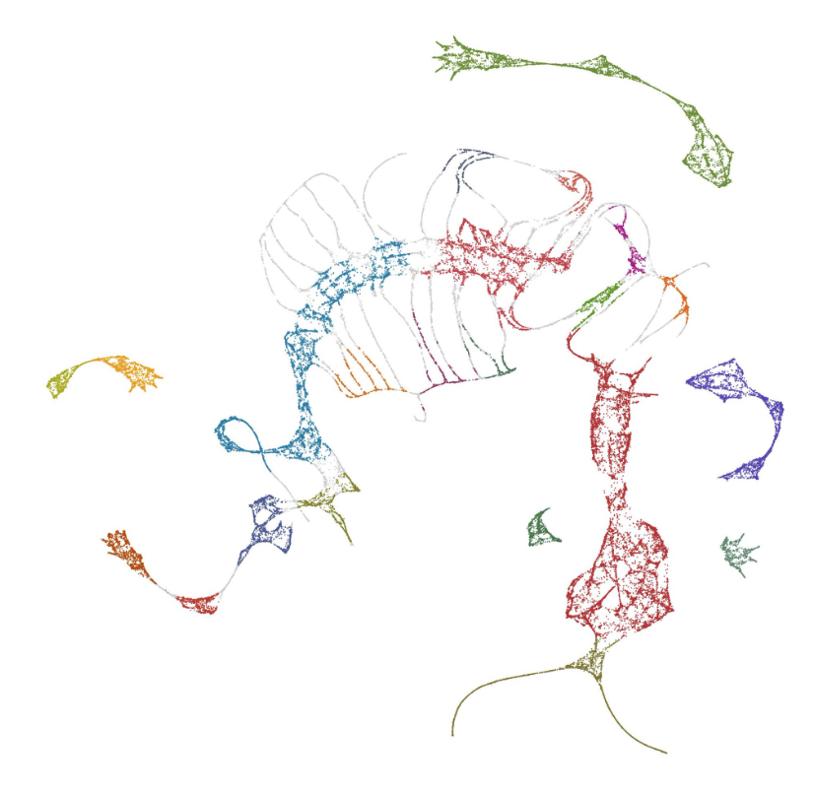
Q: What’s this?
Notes:
Does anyone know what this is? Clue: Look at the curvy lines at the bottom…

Slide 27
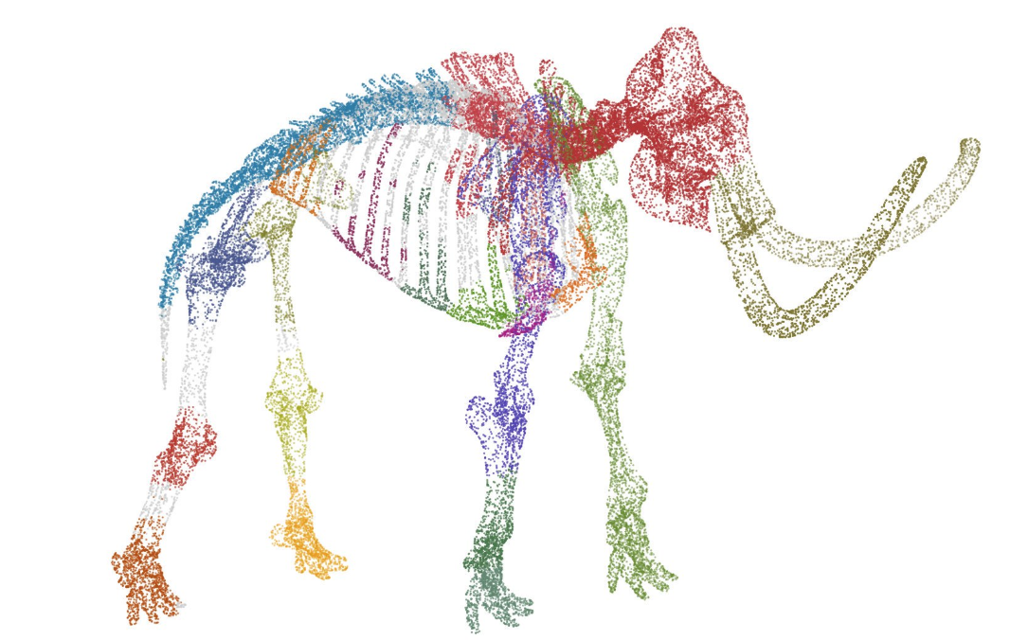
A: It’s a 2D UMAP embedding of this
Notes:
It’s a mammoth projected into 2D. Even though it’s only going from 2D to 3D, it helps develop intuition for what UMAP is doing.

Slide 28
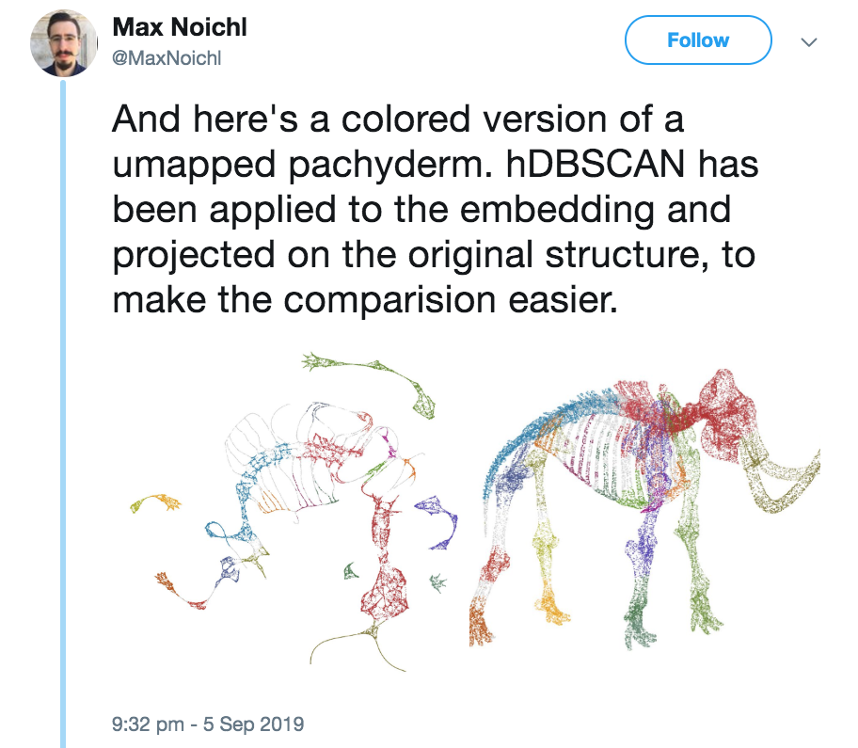
Notes:
Here’s the original tweet.
You can use the colours to map. E.g the spine in blue and the head in red, the tusks in ochre (green).
They are connected.

Slide 29
UMAP and t-SNE
Both are dimensionality reduction techniques
UMAP = Uniform Manifold Approximation and Projection
t-SNE = t-Distributed Stochastic Neighbor Embedding
Both capture local structure well
UMAP generally captures global structure better than t-SNE
UMAP is faster than t-SNE
UMAP has strong mathematical underpinnings
https://umap-learn.readthedocs.io/en/latest/how_umap_works.html
Notes:
You may have heard of t-SNE which is a similar technique. Both can be used for dimensionality reduction.
UMAP is better at capturing global structure. 2D Mammoth looks like a kind of stretched version of the 3D one.
UMAP is generally faster than t-SNE.
UMAP has a deep mathematical underpinning. You can read about the maths of it here (very readable)

Slide 30
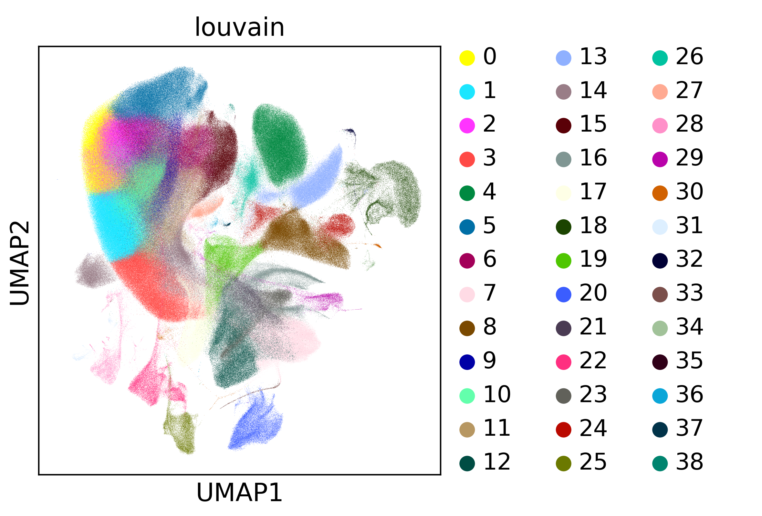
1 million cells
https://github.com/theislab/scanpy_usage/tree/master/170522_visualizing_one_million_cells
Notes:
Going back to cells. Here is a UMAP plot for the 1m cell dataset.
We have gone from 30K dimensions to 2.

Slide 31
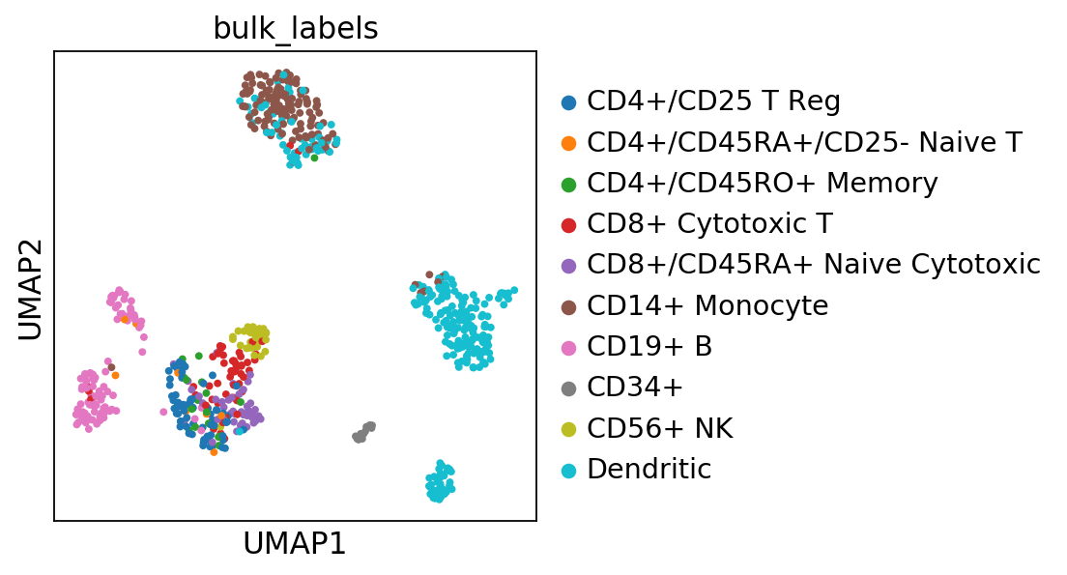
Ascribing biological meaning
https://scanpy-tutorials.readthedocs.io/en/latest/visualizing-marker-genes.html
Notes:
This is a much smaller dataset - a few hundred blood cells.
It’s possible to ascribe biological meaning to the clusters.
This is the kind of analysis that lead to a new liver cell subtype to be discovered.

Slide 32
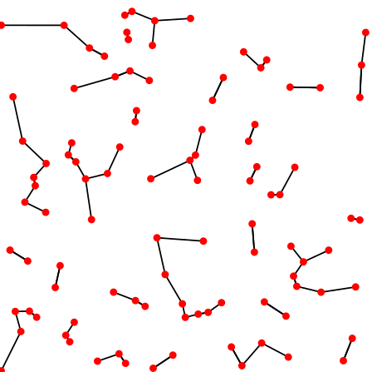
Nearest Neighbours
Find the k nearest neighbours for N points
k = 1
Intuition: points closer in space are more similar
By David Eppstein - Own work, CC0, https://commons.wikimedia.org/w/index.php?curid=16506462
Notes:
UMAP needs the concept of distance to work.
And colouring clusters (using something called the Louvain algorithm) does too.
So we need to calculate the nearest neighbours for each point.
This is done before UMAP.
NN is a very simple idea. It’s posibly the simplest machine learning algorithm on the planet. The reason we want to find the nearest neighbor for a cell, is that intuitively, “nearby” cells are likely to be similar to that cell.
“Nearby” is not in physical space, but in the reduced space of 50 dimensions from PCA.
The diagram shows finding the nearest neighbour for each point.
So in the 50 dimensional space we want to find the nearest neighbors for each cell. For example, we want to find the 30 nearest neighbors.

Slide 33
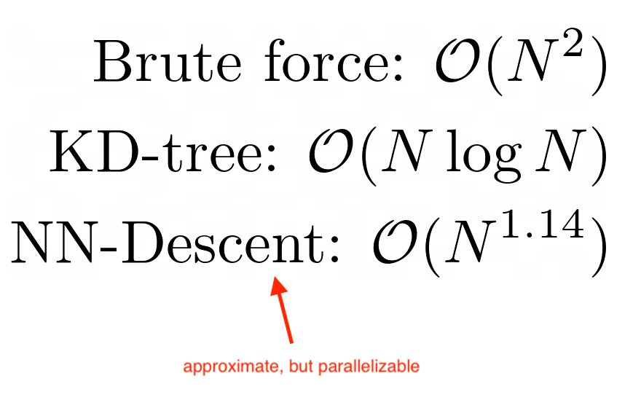
Nearest Neighbours Algorithms
Notes:
Although NN is a simple idea, there are lots of clever algorithms out there. Some of them are quite new (last decade or so).
The most naive implementation would be to check each cell against every other. This works but is very slow, since it has quadratic complexity.
There are better algorithms. For example, KD-Tree, which is used in Scikit Learn, has much better performance.
NN-Descent is another algorithm, which in practice has the same complexity as KD-Tree, but it is approximate (which is good enough for the application here), and it is parallelizable, which is very important in practice.
If you are interested, take a look at the paper. Python implementation: pynndescent.

Slide 34
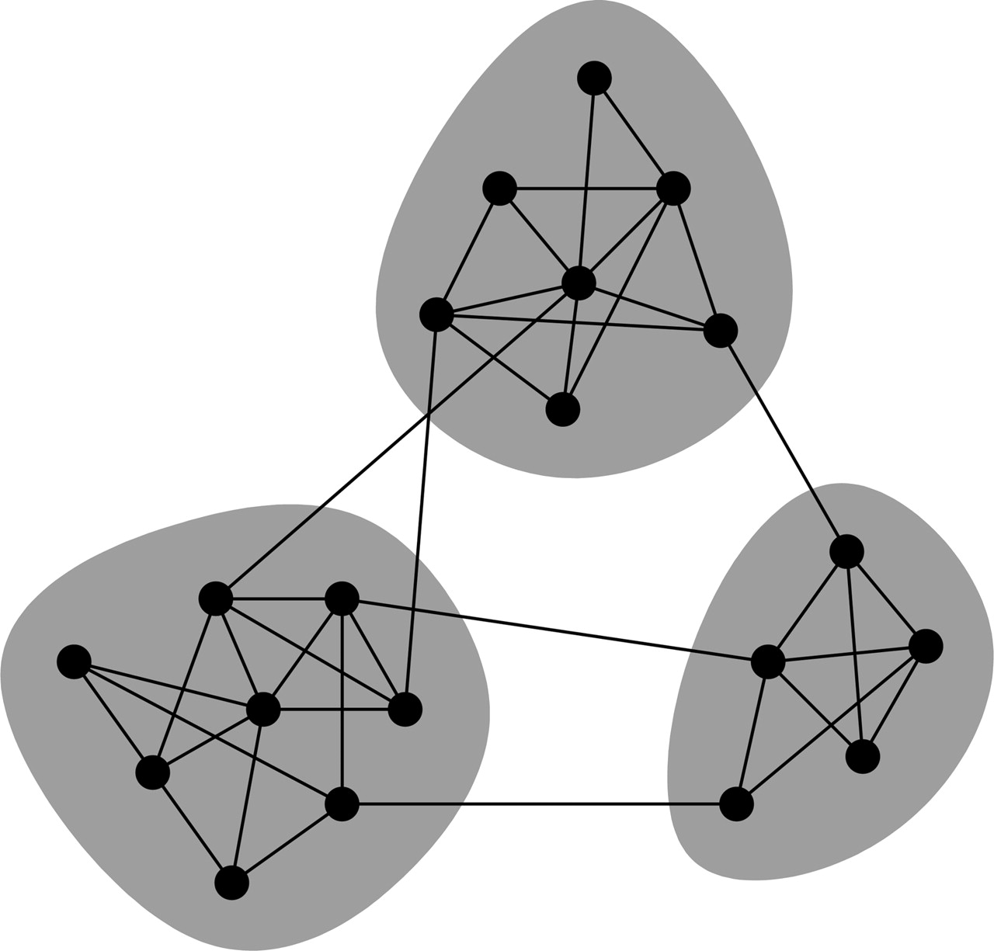
Louvain Community Detection
Clustering algorithm to find communities
Uses nearest neighbour graph as input
Key concept is modularity
Modularity compares the density of links within communities and those between communities
https://www.pnas.org/content/103/23/8577
Notes:
OK, now we have the neighbors for each cell, we can perform clustering.
The core idea here is that we want to optimize something called modularity - it’s defined for the whole network.
Modularity compares the density of links within communities and those between communities.
We want the density within a community to be high, and between communities to be low.

Slide 35
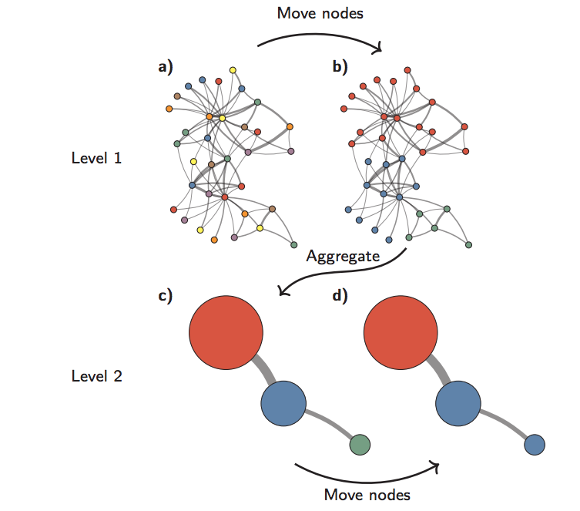
Louvain Algorithm
https://arxiv.org/pdf/1810.08473.pdf
Notes:
The Louvain algorithm is conceptually very simple.
a. Start with every node in its own partition - this is shown by each node having a different colour.
b. Then try to move each node into its neighbors community - choose the one that increases the modularity the most.
c. Then aggregate communites - and start again.
Stop when there is no improvement in modularity.

Slide 36
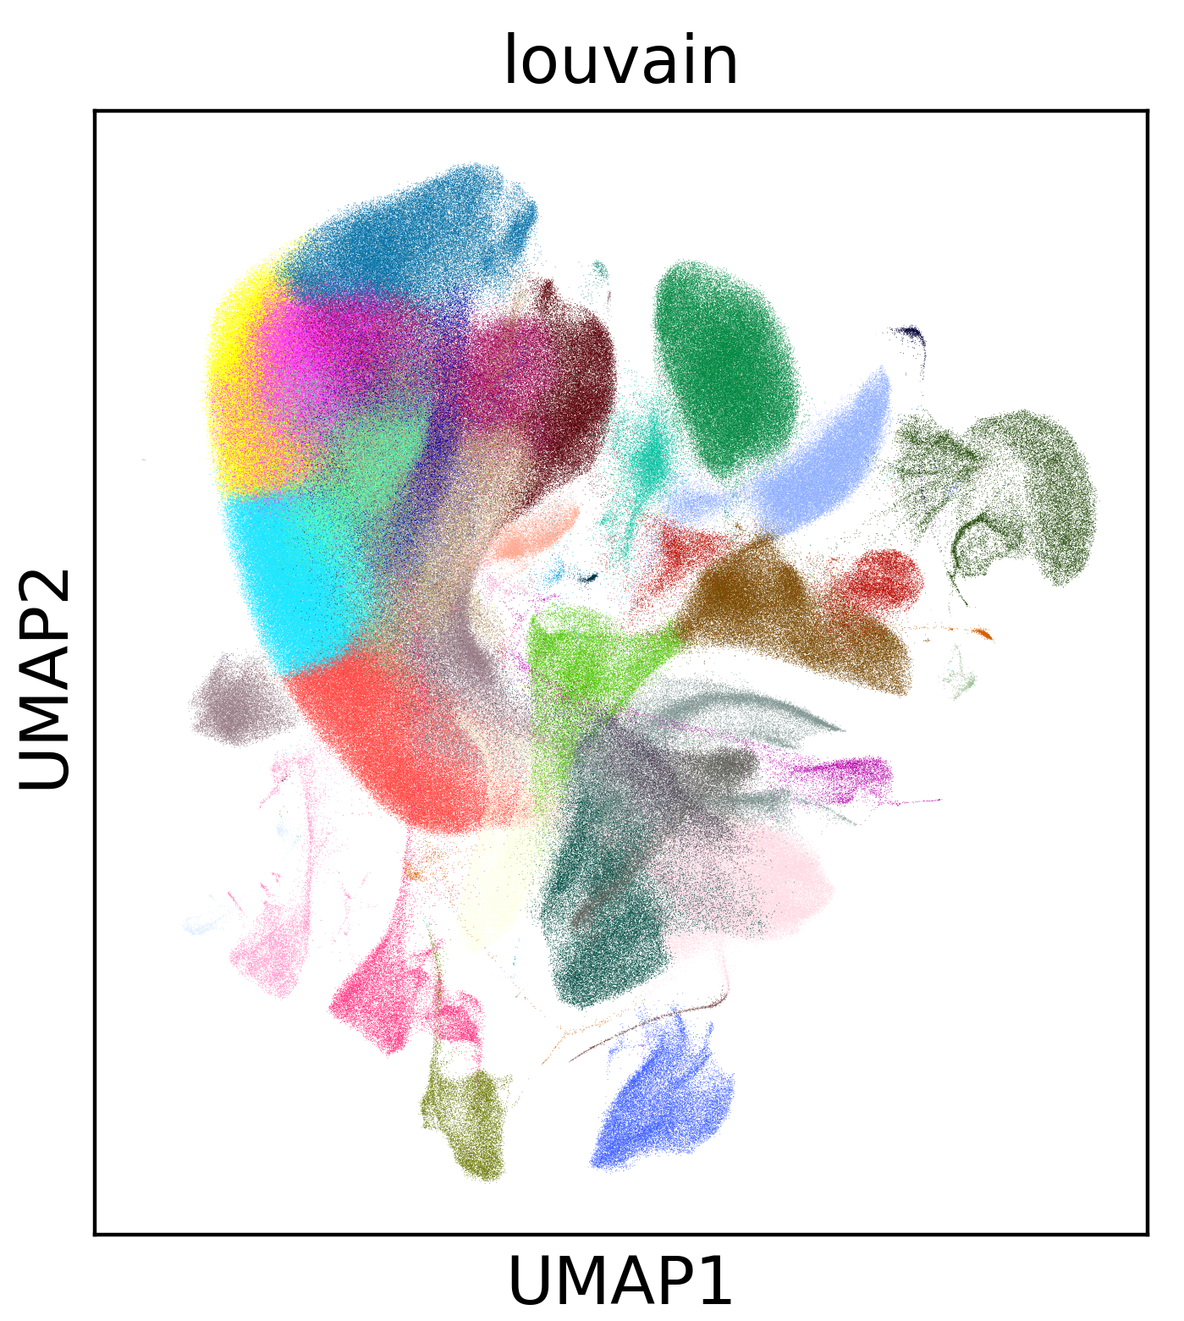
Algorithm Summary
Nearest neighbours to find 30 most similar cells for every cell
Louvain to cluster cells into communities of similar cells
UMAP to visualize the result
Notes:
So, to summarize. We use nearest neighbours to find the “nearest” 30 cells to each other. Then we use Louvain to cluster cells into communities. Then we use UMAP to view the result.

Slide 37
Compute
Notes:
So far I’ve talked about data and algorithms in abstract terms. Let’s make it a bit more concrete by talking about compute.
Ideally we want to be able to represent data and express algorithms at a very high-level - so they are as terse as possible - yet still have very good performance.

Slide 38
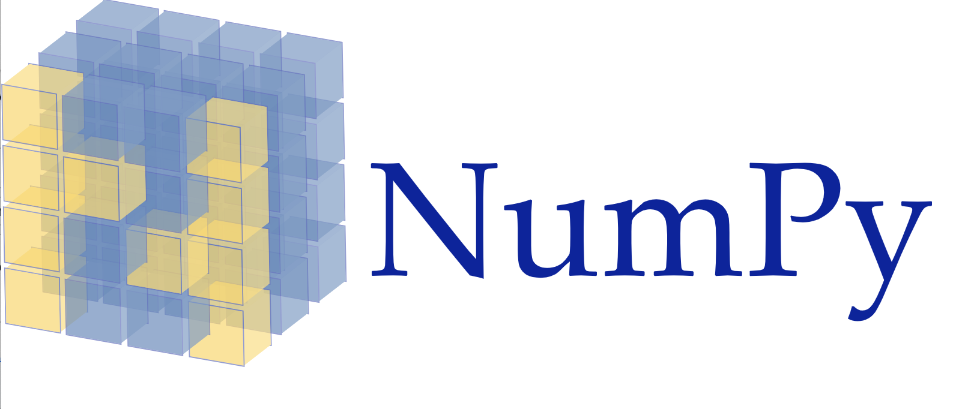
The PyData Ecosystem
NumPy
Multi-dimensional arrays
Pandas
Dataframes
Scikit-learn
Machine Learning
… and many more projects
Notes:
The PyData ecosystem is a very popular choice for doing science, since it manages to achieve these goals.
The core project is probably NumPy, its the de facto standard API for n-dimensional arrays.
Pandas provides the standard datadrame abstraction.
And scikit learn is the standard ML library
There are many more projects in the pydata ecosystem

Slide 39
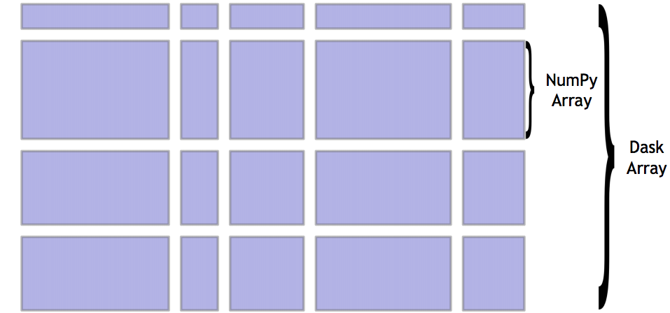
Dask
“Dask natively scales Python”
API compatible with PyData
Dask Array - NumPy
Dask Dataframe - Pandas
Dask-ML - Scikit-learn
1000 node clusters - or a laptop
Natural fit with Zarr storage
Notes:
PyData works very well on single CPU systems. FIne for 95% of use cases.
Dask addresses the other 5% of cases where you need something faster.
It has subprojects that implement the API for numpy, pandas and sk.
A dask array, for example, coordinates access to a grid of numpy arrays. So if you do a sum operation, it know how to delegate to the underlying arrays. It can distribute these computations across threads, or cores in a cluster of machines.
It runs equally well on a laptop or a cluster with 1000s of cores.

Slide 40
Apache Spark or Dask?
Spark
Records
SQL
JVM-centric
Scales to 1000s of cores
Multiple second startup for local cluster
Dask
Arrays or records
SQL not included
Python only
Scales to 1000s of cores
Subsecond startup for local cluster
Notes:
Dask has many similarities with Spark.
Both are very mature systems at this point.
Simplifiying a bit Spark is good for record-based data, especially if you are using SQL.
Dask suits more scientfic or data science analysis. Working with array data or records - e.g. if you are using numpy or pandas for example.
Spark is built on the JVM whereas Dask is python native - and python only. Better fit with Python community.
Both scale to 1000s of cores, but Dask is slightly preferable when running on a single machine since it has the startup time of starting a thread basically.

Slide 41
Scaling PyData
Scale up (accelerate)
PyData
Single CPU
Dask
Multi CPU
Scale out (parallel)
Via https://twitter.com/mrocklin/status/1108060117495218176

Slide 42
Scaling PyData
RAPIDS
Single GPU
Scale up (accelerate)
PyData
Single CPU
Scale out (parallel)
Via https://twitter.com/mrocklin/status/1108060117495218176

Slide 43
Scaling PyData
Dask + RAPIDS
Multi GPU
Scale up (accelerate)
PyData
Single CPU
Scale out (parallel)
Via https://twitter.com/mrocklin/status/1108060117495218176

Slide 44
Scaling PyData
RAPIDS
Single GPU
Dask + RAPIDS
Multi GPU
Scale up (accelerate)
PyData
Single CPU
Dask
Multi CPU
Scale out (parallel)
Via https://twitter.com/mrocklin/status/1108060117495218176
Notes:
There are two approaches to scaling.
Scaling up means getter bigger or faster computers. In this diagram we can speed up PyData by using RAPIDS - a drop in replacement for various PyData projects (like NumPy or Pandas) that runs on a GPU.
Scaling out means getting more resources to do processing in parallel. Dask can be used to scale out PyData - to run a computation on multiple CPUs rather than one. It can also be used to scale out RAPIDS by running on multiple GPUs.

Slide 45
Summing 2TB of random data
RAPIDS
One GPU: 1min 37s
Dask + RAPIDS
8 GPUs: 19s
Dask (single threaded)
One CPU core: 2hr 39min
Dask (multi-threaded)
40 CPU cores: 11min 30s
Details: http://matthewrocklin.com/blog/work/2019/01/03/dask-array-gpus-first-steps
Notes:
Here are some concrete numbers from Matthew Rocklin. He generated 2TB of random data and then performed a sum operation to reduce it to a single number.
On a single CPU this took 2 hour and 39 minutes.
Using Dask with 40 CPUs took 11min 30s.
Using RAPIDS on a single GPU it took …
Finally using RAPIDS and Dask it took …
That’s a huge performance boost. But bear in mind this is probably the best case for a couple of reasons.
First, the data is generated on the GPU - in practice, you have to transfer it from CPU memory, which is slower.
Second, in real processing pipelines, data is shuffled - which slows things down.

Slide 46
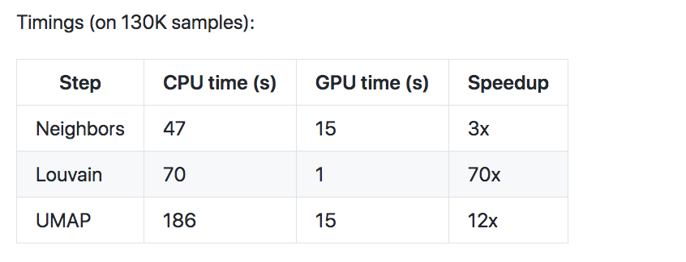
Speeding up Single Cell analysis
Details: https://github.com/tomwhite/scanpy_usage/tree/rapids-gpu/1909_rapids_gpu
Notes:
Going back to a real workload, 130 thousand cells, we get the following speedups.
These are all running on a single GPU. All pretty impressive!
One caveat - these are all graph processing algorithms, so the dataset needs to be resident in memory - so we can’t use dask to scale to multi GPU.

Slide 47
Do we still need clusters?
M2-ultramem-416
416 vCPUs
11.7 TB memory
10⁸ cells
nvidia-tesla-v100
8 GPUs
96 vCPUs
624 GB memory
https://cloud.google.com/compute/docs/machine-types
Notes:
Here’s a parting thought.
It very easy to get machines stuffed with CPUs and GPUs. E.g. a machine w 400 CPUs and 11 TB of memory!
Or 8 GPUs and 96 CPUs.
These are very powerful and are effectively a cluster in a box.
We can reach the 100 million cell mark with this compute - possibly more.
It’s obvious we must make our algorithms work on multiple cores and GPUs. But it’s not obvious we should turn to clusters straightaway - try a single machine first - much simpler.

Slide 48
Thank you
Tom White
@tom_e_white
Illustration by David S. Goodsell, the Scripps Research Institute.

Slide 50
Scaling Nearest Neighbours
Nearest neighbours in RAPIDS is limited by memory of a single GPU (16GB)
Can we parallelize it?
Nearest neighbours is a graph algorithm
Difficult to parallelize efficiently in general
But, NN-Descent has a MapReduce style parallel algorithm
https://github.com/lmcinnes/pynndescent
Works very well on multiple CPUs with shared memory
We have >>16GB available so can scale a lot further (potentially 100 million cells)
~3x speedup with 16 CPU cores running on 130K cells
computing neighbors
using 'X_pca' with n_pcs = 50
finished (0:01:31.54)
computing neighbors
using 'X_pca' with n_pcs = 50
finished (0:00:32.02)

Slide 51
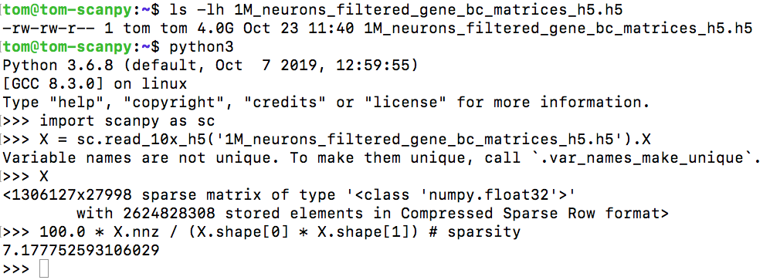
Gene expression matrix data

